Slide 1
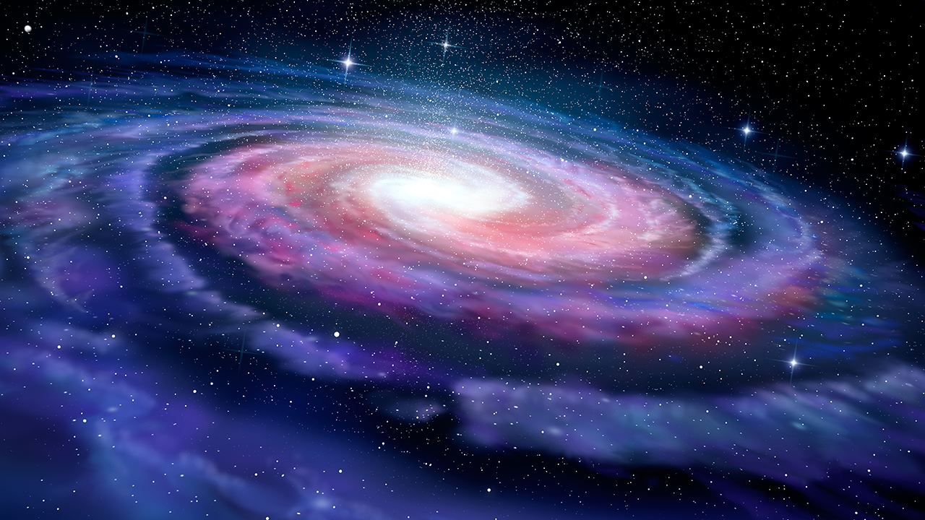
Is There Life Out There?
A Baha’i Perspective

Slide 2
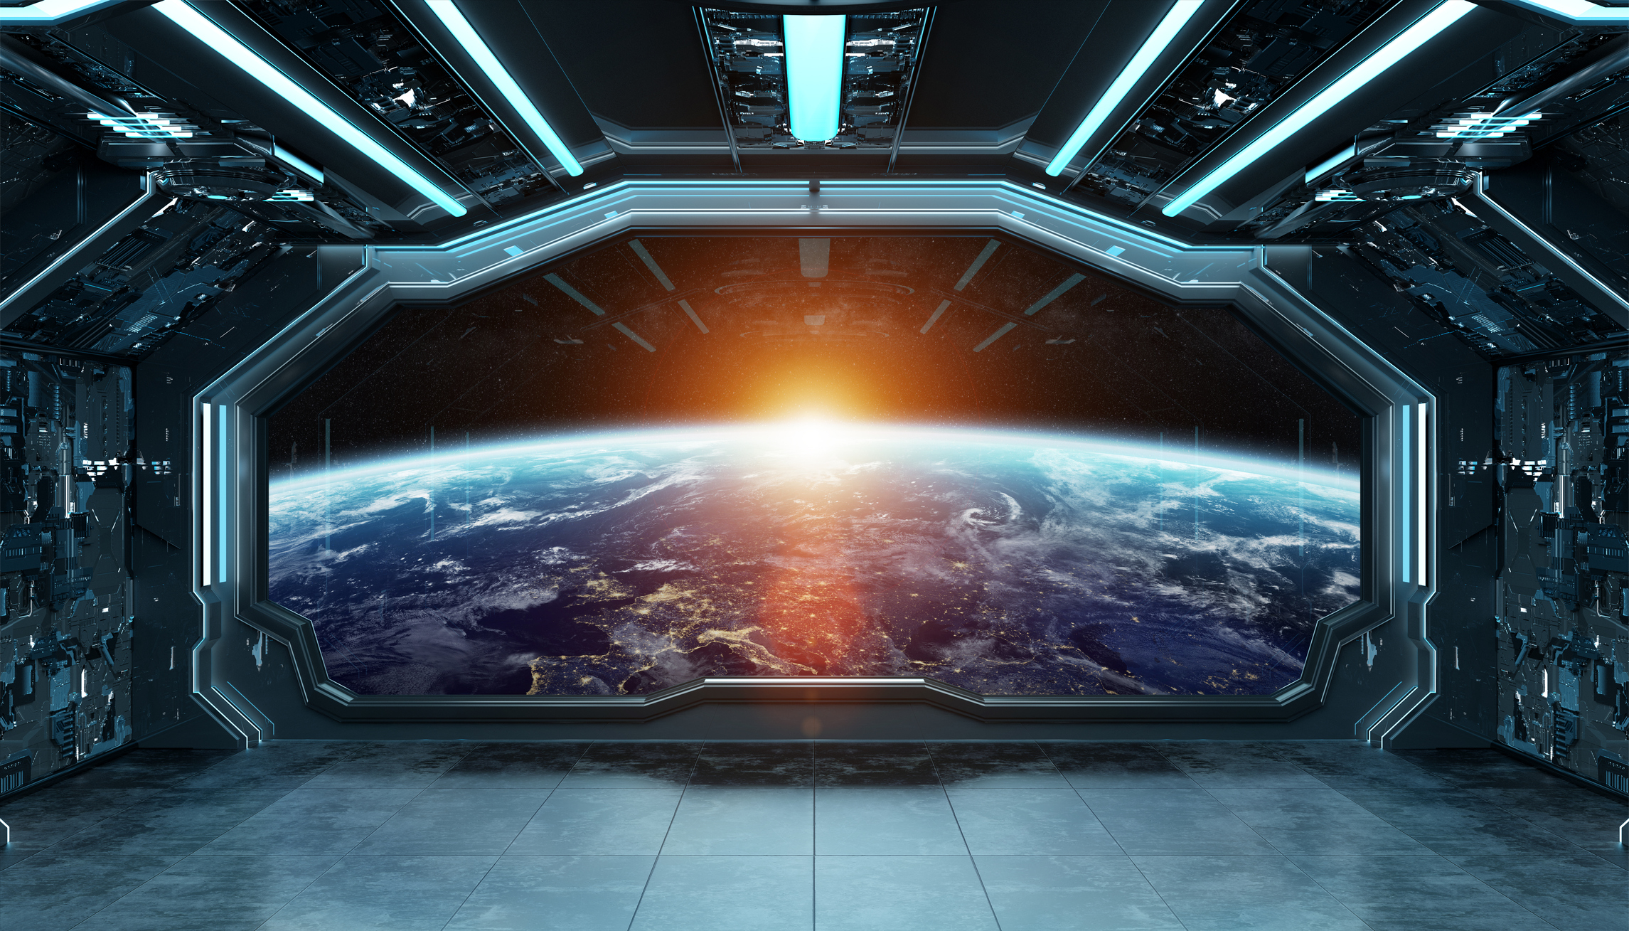
The Big Picture
“Space is big. You just won't believe how vastly, hugely, mind-bogglingly big it is. I mean, you may think it's a long way down the road to the chemist's, but that's just peanuts to space.”
Douglas Adams

Slide 3
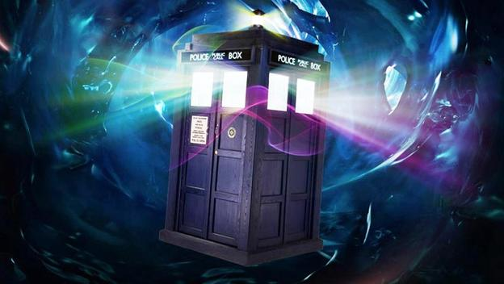
The Universe is Strange
The universe is vast, strange, and doesn’t revolve around us.
This Photo by Unknown Author is licensed under CC BY-NC-ND

Slide 4
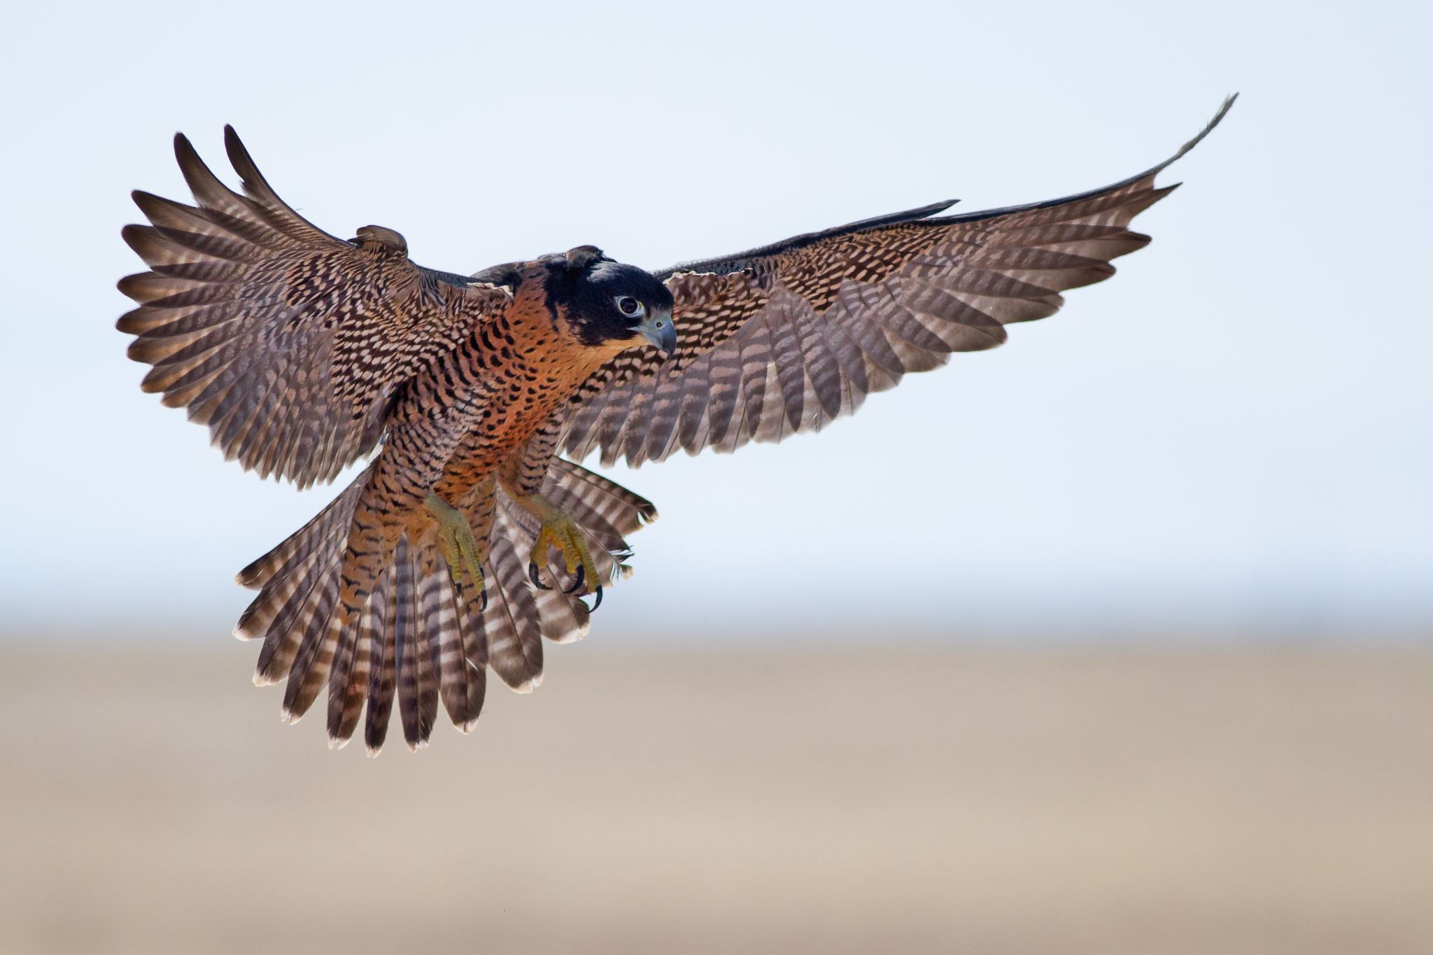
Science and Religion
“Religion and science are the two wings upon which man’s intelligence can soar.”
Abdul Baha

Slide 5
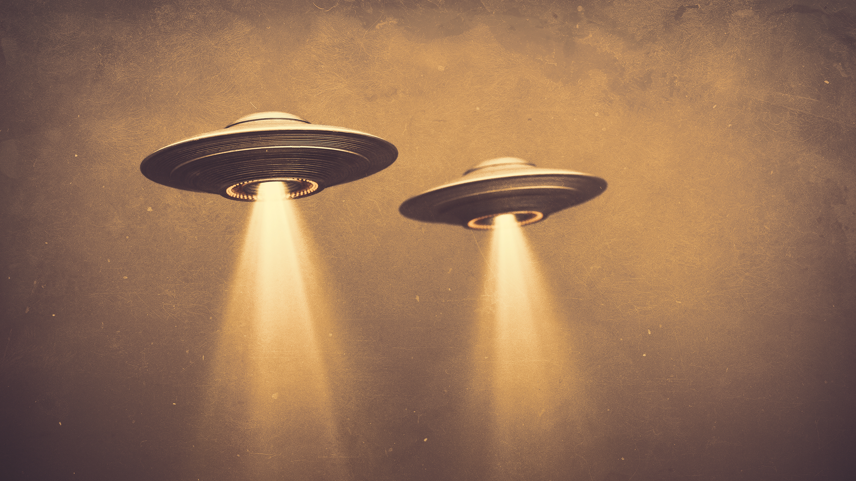
Do Aliens Exit?
“Know thou that every fixed star hath its own planets, and every planet its own creatures, whose number no man can compute.”
Baha’u’llah

Slide 6
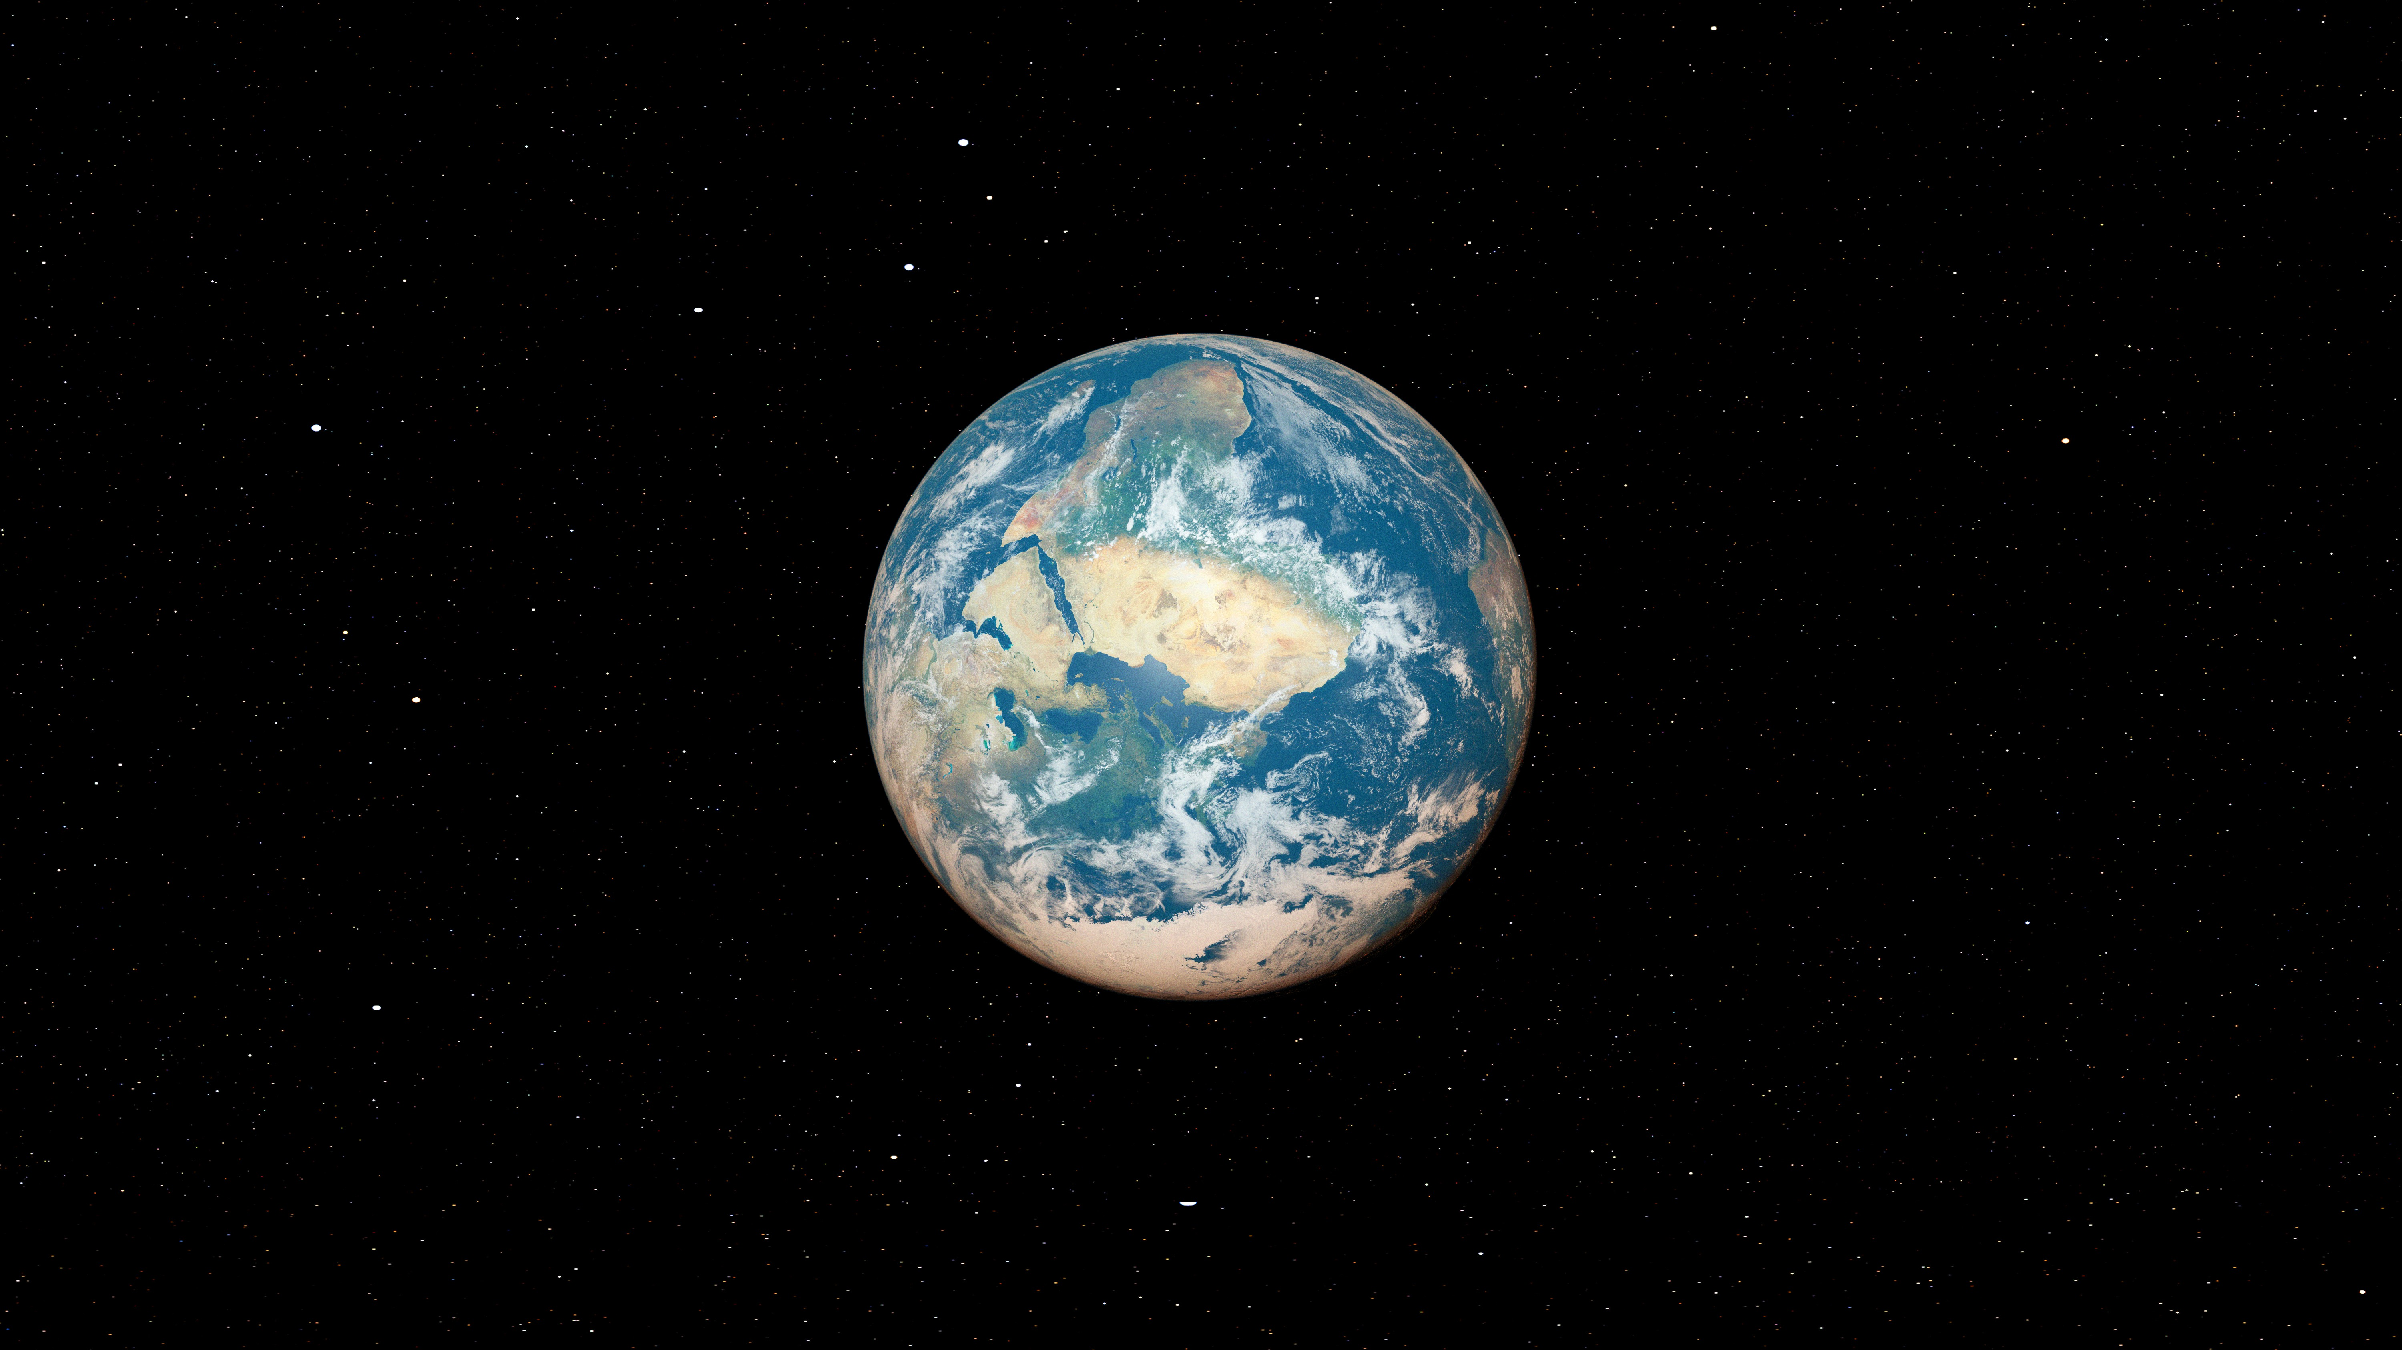
The View of Earth
“She could not see countries, with firm lines and borders. She saw only landmasses, undivided”.
Taylor Jenkins Reid, Atmosphere
“The Earth is one country and mankind its citizens”.
Baha’u’llah

Slide 7

A Deep Question
The question isn’t “Are we alone in the universe?”
It’s “Are we learning how to live well together on this planet?”

Slide 8

An Interfaith Closing Thought
Curiosity.
Kindness.
Respect.

