Slide 1
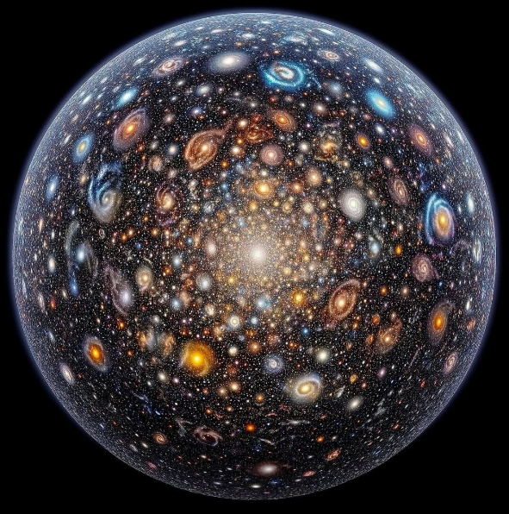
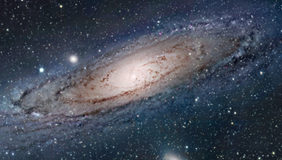
Is There Life Out There?
A Sikh Perspective
Notes:
SLIDE 1 — Opening hook
Deliver the title as a genuine question — pause after each word if you like.
Let the audience sit with it for a moment before moving on.

Slide 2
Humanity Has Always Asked :
ARE WE ALONE?
Ancient civilisations built myths around it.
Philosophers debated it for centuries.
Scientists today dedicate careers to it.
SIKH perspective (NO)
Sikh scripture (1500)– There are countless galaxies with stars and planets
The creator is infinite without limit and his creation reflects that infinity.
Human mind cannot fully grasp it.
If life exists elsewhere, it just reflects HIS creativity
02
Notes:
SLIDE 2 — The question
"For as long as humans have looked up at the night sky, we've asked the same question: are we alone?
Ancient civilisations built myths around it. Philosophers debated it for centuries. Scientists today dedicate careers to it. This question is not new — but our ability to answer it has never been greater."

Slide 3
Sikh scriptures state that there is 8.4 million forms of life – life is not rear
Life is in abundant throughout the creation (we need to understand LIFE)
Modern Astronomy
There are over 2 Trillion galaxies in the observable universe.
- Each galaxy has Billions of stars
Each star hopefully will have a number of planets (8000+ Exoplanets identified)
Probability of life on one of these planet is quite high.
Nearest star (Alpha Centauri) is 4.3 light years away.
It would take 72000 years to get there.
We may not see life on other planets in our life time.
03
Notes:
SLIDE 3 — Science
"In 1995 we had zero confirmed planets outside our solar system. Today we have over five thousand. The Milky Way alone contains up to 400 billion stars — many with planets in the so-called habitable zone, where liquid water could exist.
With the James Webb Space Telescope, we can now analyse the atmospheres of distant worlds for signs of life. The question is no longer 'is it possible?' — it's 'when will we find it?'"

Slide 4
Sikhism - Guru Granth Sahib says that the One Light (soul) pervades all creation.
The light inside you and me is not separate. It comes from the same Source.
So imagine this: if life exists somewhere else in the universe, that life too would carry the same divine light. Different form. Different body. Maybe completely different biology. But sustained by the same Creator.
Here is something we all share.
Bible - we read that the heavens declare the glory of God.
Islam - God is described as Lord of the worlds.
Bahá’í - creation is described as vast and unfolding.
Across our traditions, there is a shared recognition that the universe reflects divine majesty.
03
Notes:
SLIDE 3 — Science
"In 1995 we had zero confirmed planets outside our solar system. Today we have over five thousand. The Milky Way alone contains up to 400 billion stars — many with planets in the so-called habitable zone, where liquid water could exist.
With the James Webb Space Telescope, we can now analyse the atmospheres of distant worlds for signs of life. The question is no longer 'is it possible?' — it's 'when will we find it?'"

Slide 5
Whether or not there is life “out there,” the deeper spiritual question is how we live right here.
Are we living truthfully?
Are we serving one another?
Are we recognizing the Devine in everyone?
Because discovering life in a distant galaxy would be extraordinary
BUT
Discovering humility, compassion, and unity among ourselves — that may be even more extraordinary.
From a Sikh perspective, the universe is vast, mysterious, and filled with divine presence. And whatever exists out there , exists within that ONE
03
Notes:
SLIDE 3 — Science
"In 1995 we had zero confirmed planets outside our solar system. Today we have over five thousand. The Milky Way alone contains up to 400 billion stars — many with planets in the so-called habitable zone, where liquid water could exist.
With the James Webb Space Telescope, we can now analyse the atmospheres of distant worlds for signs of life. The question is no longer 'is it possible?' — it's 'when will we find it?'"

